Slide 1
Analytical Decision Making Introduction
Olivier Rubel, Ph.D.,
Associate Professor of Marketing

Slide 2
Outline
Introduction and Class Administration
Elements of Modeling and Pricing Analytics

Slide 3

Me
Associate Professor of Marketing
PhD in Marketing with some OR
Econ background
Current research
Methodologically
Dynamic optimization
Dynamic game theory
Time series econometrics
Substantive issues
Marketing dynamics
Coordination of sales and marketing
Sales force management

Slide 4
Learning Objectives of the Course
To think analytically about decision making
Not to solve optimization problems in Python
Even though you should be able to do some of that by the end of the first part
To acquire a useful tool box
To provide bases for future learning about decision making

Slide 5
Evaluation
Participation: 20%
Homework 1: 20%
Will cover Lectures 1 to 3
Homework 2: 20%
Will cover Lectures 4 to 8
Mini-Quiz # 1: 15%
Will cover Lectures 1 to 4
Mini-Quiz # 2: 15%
Will cover Lectures 5 to 8
Group Project: 10%
More information to be posted

Slide 6
The Class
Part A: Optimization and Operations Research
Lecture 1: Modeling
Lecture 2: Linear Programming I
Lecture 3: Linear Programming II
Lecture 4: Non Linear Optimization
Lecture 8: Dynamic Programming
Lecture 9: Dynamic Programming
Part B: Economic Engineering
Lecture 5: Decision Analysis and Decision under Risk
Lecture 6: Game Theory
Lecture 7: Incentives and Mechanism Design

Slide 7
Business Analytics
Estimation and Control
Measurement and decisions
Machine Learning and “AI”
Decisions
Optimization: Tactical (Micro) vs. Strategic (Macro) decisions
Economics: Management of scarce resources
Discovery of the price/cost/value of alternatives to guide decisions

Slide 8


Selling Diapers vs. Selling Fashion
Notes:
Inspired by “the new product bet” by Rudi and Netessine
How do these two examples different substantially?

Slide 9
Selling fashion is similar to selling
Digital ads
Airline tickets
Hotel rooms

Slide 10
Art of Modeling
Framework
Typical
problem
Typical
solution
Abstraction
Application
Specific
problem
Specific
solution
Trial & error

Slide 11
Why Models?
Building a model often reveals relationships that were not apparent to many people. As a result, a greater understanding is achieved of the object being modeled.
Having built a model it is usually possible to analyze it mathematically to help suggest courses of action that might not otherwise be apparent.
Experimentation is possible with a model, whereas it is often not possible or desirable to experiment with the object being modeled.

Slide 12
Building Blocks
Decisions
Tactical vs. Strategic
Objectives
Maximize profit and minimize cost, only?
Decision makers?
Constraints
Physical
Economics
Business rules
Legal
Industry norms
Notes:
Missing: Decision makers

Slide 13
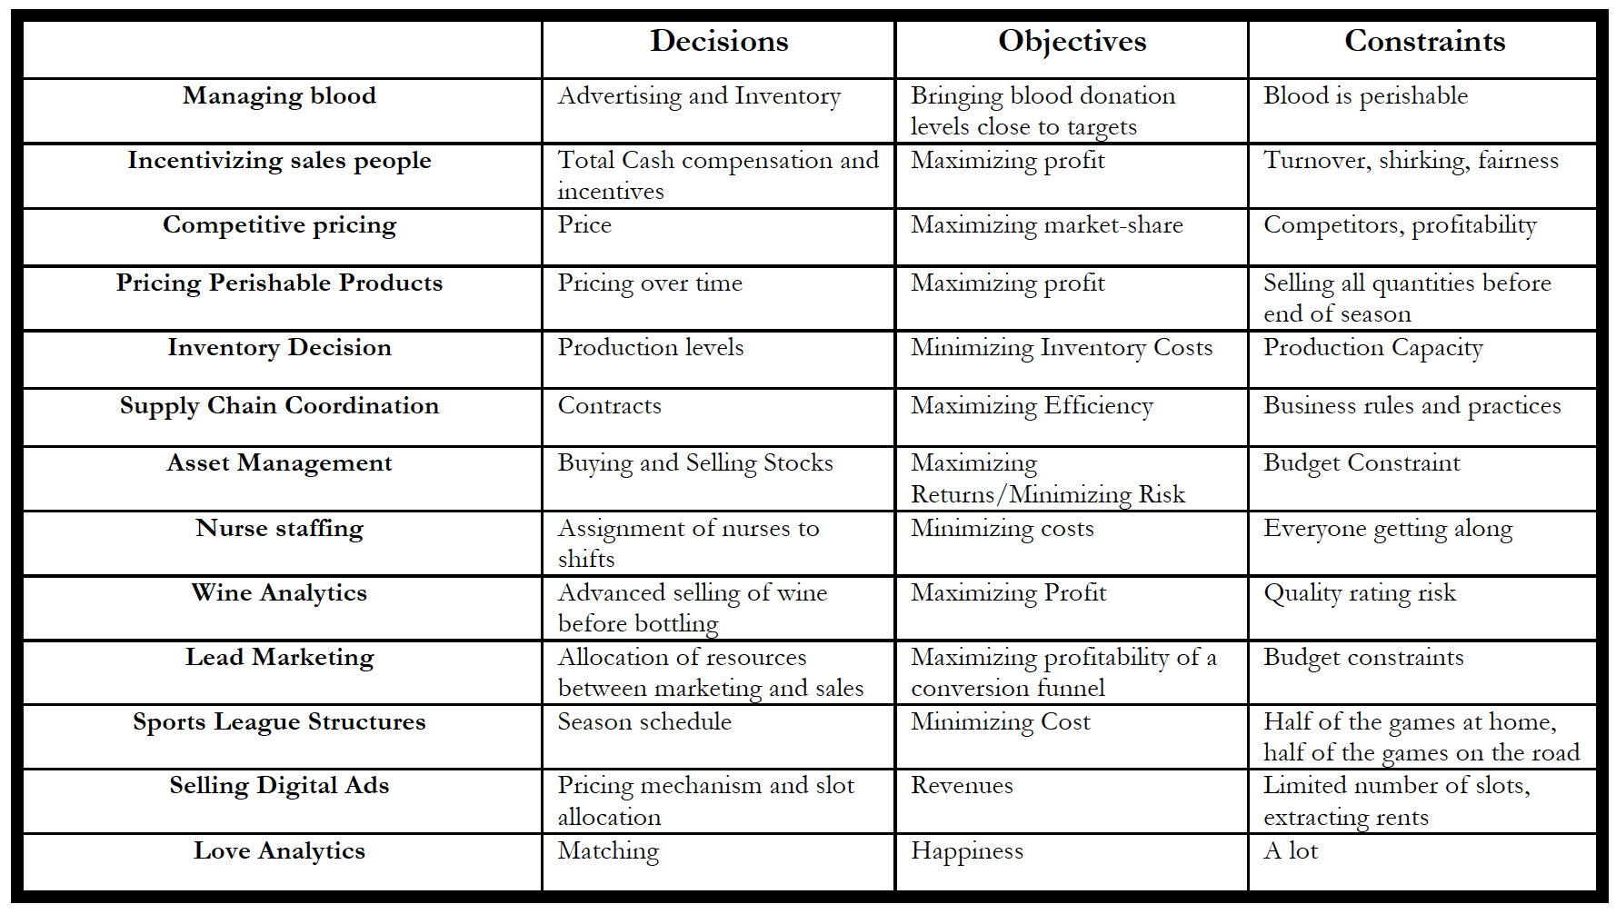
Business Analytics

Slide 14
Mathematical Model

Slide 15
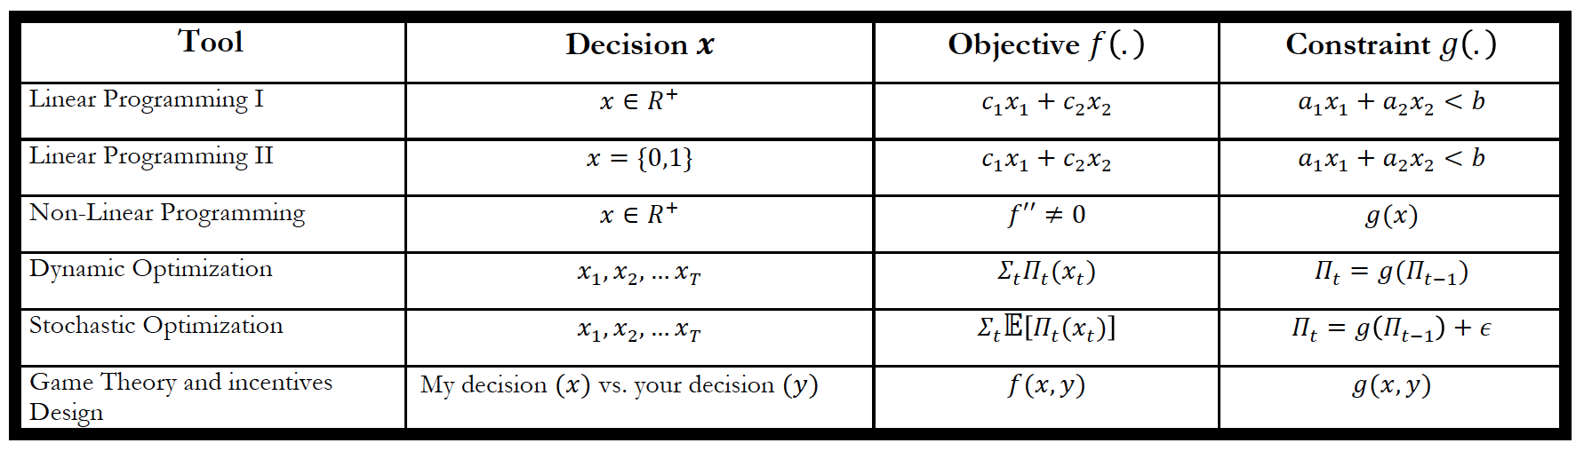
Decision Analytics

Slide 16
Why the Math?
Reason # 1
“The purpose of models is not to fit data but to sharpen the questions”
Reason # 2
Can be implemented in a spreadsheet or modeling language (computer) to identify solutions

Slide 17
Pricing Analytics
“The single most important business decision in evaluating a business is pricing power.”
Warren Buffet
How customers respond to prices is the ultimate measure of investments in product improvement, distribution, and marketing.
Pricing is also a critical factor in determining short-run profits, volume and market-share
Despite its importance, pricing is often poorly understood, poorly managed and poorly evaluated by most companies

Slide 18
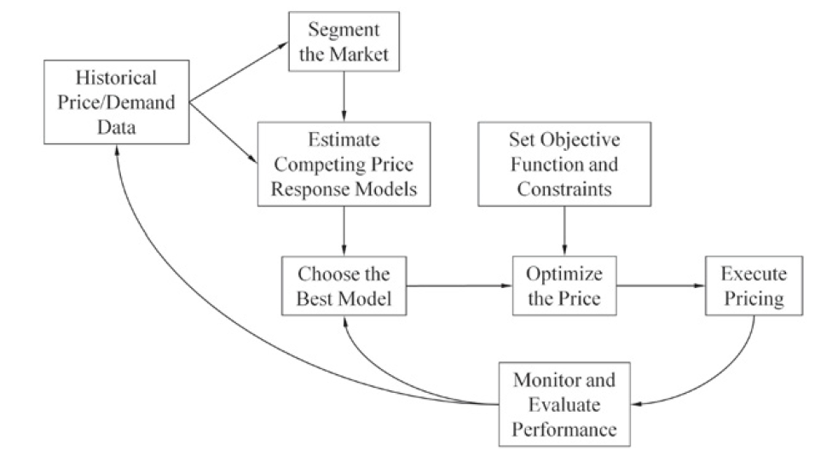
Pricing Analytics Process
Notes:
From Bodea and Ferguson “The Theory of Pricing Analytics”

Slide 19
Price Optimization
Decisions: Prices and/or allocation of different products and services to different customers through different channels
Objective: usually to maximize expected net contributions
Constraints: One or more
Physical limitation in capacity or inventory
Business or marketing rules
Legal limitations
etc

Slide 20
Choosing the Best Model/Approach
Static vs. Dynamic
Deterministic vs. Uncertainty
Linear or non Linear pricing
Monopoly vs. Competition
Vertical vs. Horizontal strategic interactions
Thus, choosing the right price requires to consider the important features of the problem

Slide 21
Remember
Selling Diapers
Historical data
Driven by needs
Mature product
Selling Fashion
No historical data
Driven by desire
New product
Selling diapers
“standard” non-linear optimization
Selling Fashion
Markdown pricing
Revenue management

Slide 22
Simple Pricing Problem
Problem: Your company is going to market a new product. As a marketing manager, you need to set a price for the product. You know the cost for a unit of product is $c. What are you going to do?
Let’s build a model to solve this problem:
What is the objective?
What is the decision you can make?
How does pricing affect your objective?
What are the factors that you need to consider?

Slide 23
Demand Function
Estimated demand function is linear
Intercept is a
Sensitivity of demand to price is b
Marginal cost of production is c
What is the optimal price?

Slide 24
Optimal Price

Slide 25
Model Solution
The analyst attempts to identify the alternative (the set of decision variable values) that provides the “best” output for the model (i.e., the optimal solution).
I need some criterion that defines optimality
If the alternative does not satisfy all of the model constraints, it is rejected as being infeasible, regardless of the objective function value.
If the alternative satisfies all of the model constraints, it is feasible and a candidate for the “best” solution.

Slide 26
Reaching a Solution
One solution approach is trial-and-error.
Might not provide the best solution
Inefficient (numerous calculations required)
Special solution procedures have been developed for specific mathematical models.
Some small models/problems can be solved by hand calculations
Most practical applications require using a computer
A variety of software packages are available for solving mathematical models.
Spreadsheet packages such as Microsoft Excel (or Google Sheet)
The optimization package such as PYOMO, CVXPY, PuLP, (All in Python)

Slide 27
Uses of Models
Tools for decision-making
model helps select a policy/action to follow
decision-maker implements the policy
Sources of insight
illuminates the relationship among many complex variables
decision-maker’s understanding of the relationship informs his/her judgment
Training tools
decision-maker selects a policy/action
model describes the outcome of following the selected policy/action

Slide 28
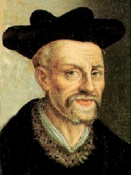
Ethics of Modeling
Hidden Assumptions
Misrepresentation of preferences
Outcome manipulation
“Science without conscience is the death of the soul”
Notes:
https://en.wikipedia.org/wiki/Fran%C3%A7ois_Rabelais
Slide inpsired by course notes by Ph. Delquie (GWU)

Slide 29
Next Class
Linear programming, see note on canvas
Python
Install
CVXPY (http://www.cvxpy.org/en/latest/)
CVXOPT (http://cvxopt.org/)
We will also use numpy, matplotlib, seaborn

Slide 30
Take Aways
To solve a decision problem, define
The decision(s)
The objective(s)
The constraint(s)
All models are wrong, but some are useful
The purpose of models is not to fit data but to sharpen the questions
Notes:
“All models are wrong, but some are useful”
Box
“The purpose of models is not to fit data but to sharpen the questions”
Samuel Karlin
“When you are lost, any old map will do”‖
(Weick, 1995: 54).

Slide 31
Metrics Trivia
Net Present Value
Elasticity

